Slide 1

Lime Tray
Food travel memories

Slide 2







INTRODUCTION

Slide 3




Existing Methodology
Drawbacks
Tedious task to maintain details and orders of all the customers.
Manual way of processing data
More time consuming

Slide 4





Proposed Methodology
Advantages
No Manual way of processing data
All the customers and order details will be secured.
Retrieval of information is easier.
High efficiency

Slide 5


Login
Admin
Users

Slide 6
Admin
ADD, DELETE &
UPDATE
LOCATION
ADD, DELETE &
UPDATE
RESTAURANT
VIEW
USER DETAILS

Slide 7





Users
SELECT LOCATION
SELECT
STOP
SELECT
RESTAURANT
VIEW AND VERIFY
THE BILL
PAYMENT MODE
CASH ONLY
SELECT ITEMS
FROM MENU
VIEW THE
MENU

Slide 8
TABLES
SIGN IN
SIGN UP
USERID | PASSWORD
NAME | USERID | EMAILID | PHONENUMBER
LOCATION
ROUTEID | TRAINNO | FROM | TO | FROMTIME | TOTIME
STOPS
ROUTEID | STOPID | STOPNAME | STOPTIME
RESTAURANT
RESTAURANTID | RESTAURANTNAME | ROUTEID
FOOD
FOODNAME | PRICE | CATEGORY | RESTAURANTID | FOODID

Slide 9
Hardware Requirements
Processor – Pentium III and above.
RAM – 256 MB and above.
Hard Disk – 20 GB.
Software Requirements
Operating System : Windows98 and above.
Front End : HTML, CSS, Bootstrap.
Language : Java.
Database Connectivity : Oracle.

Slide 10
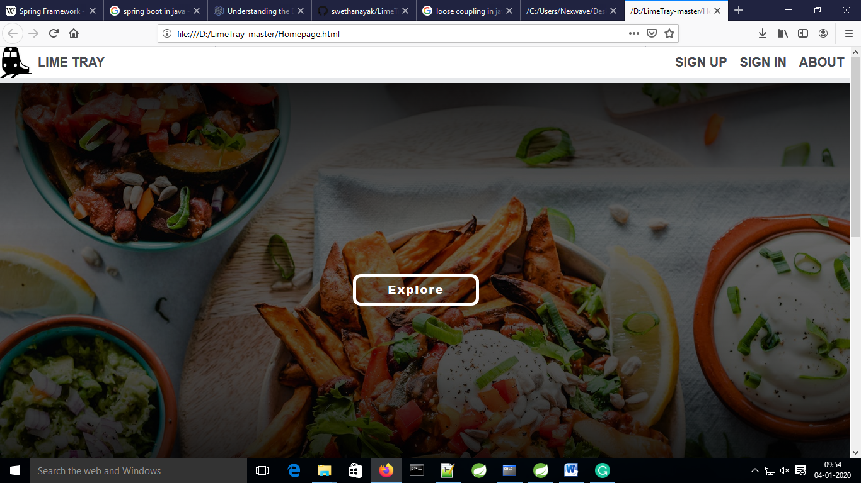
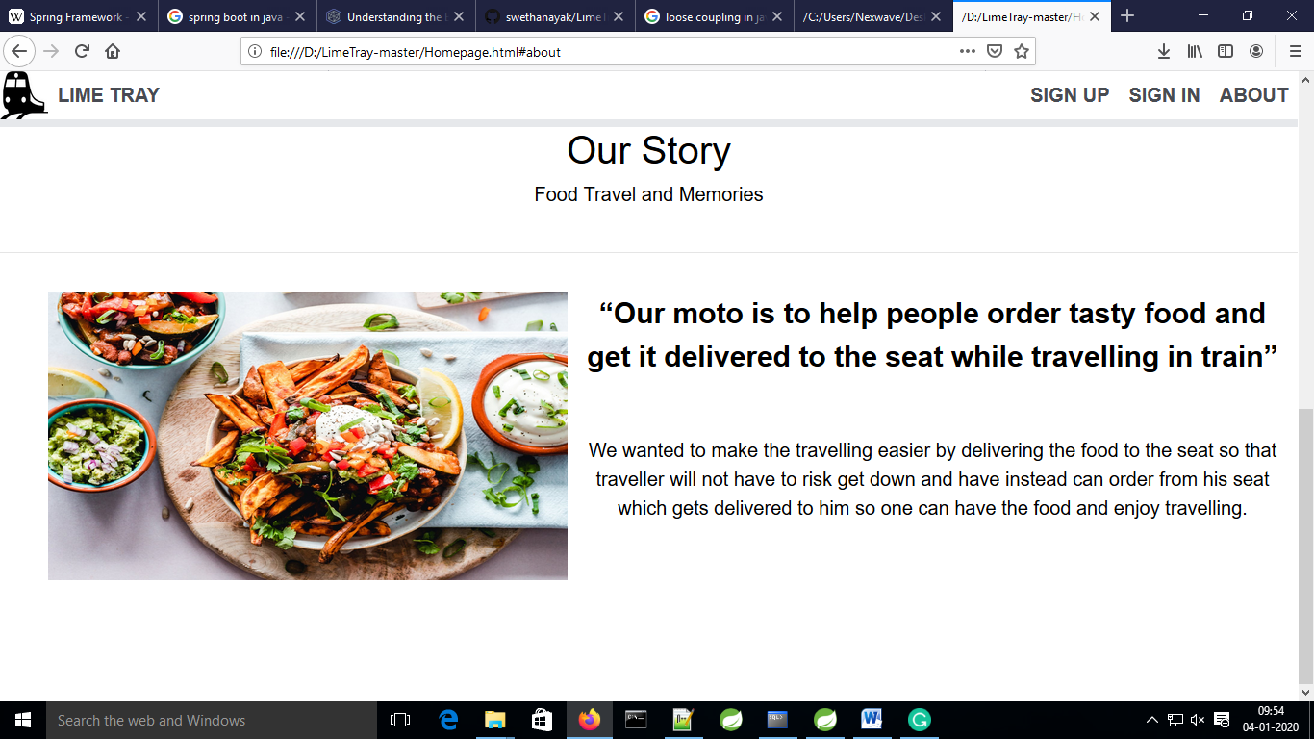
USER INTERFACE

Slide 11
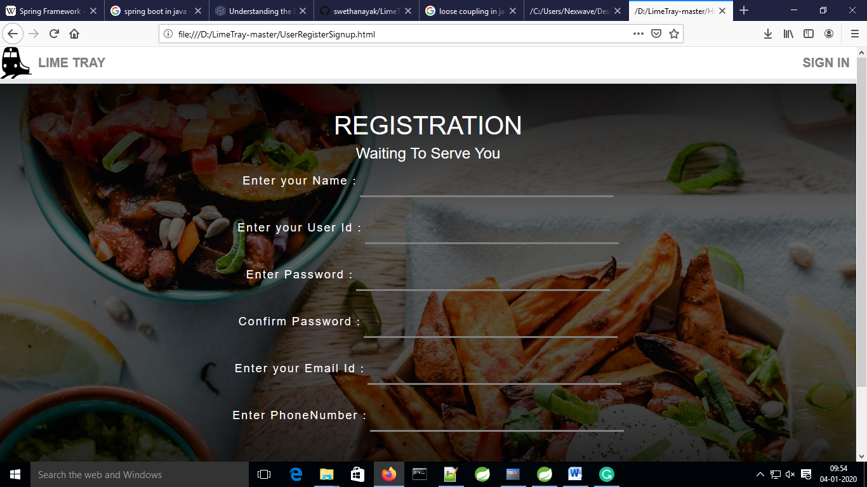
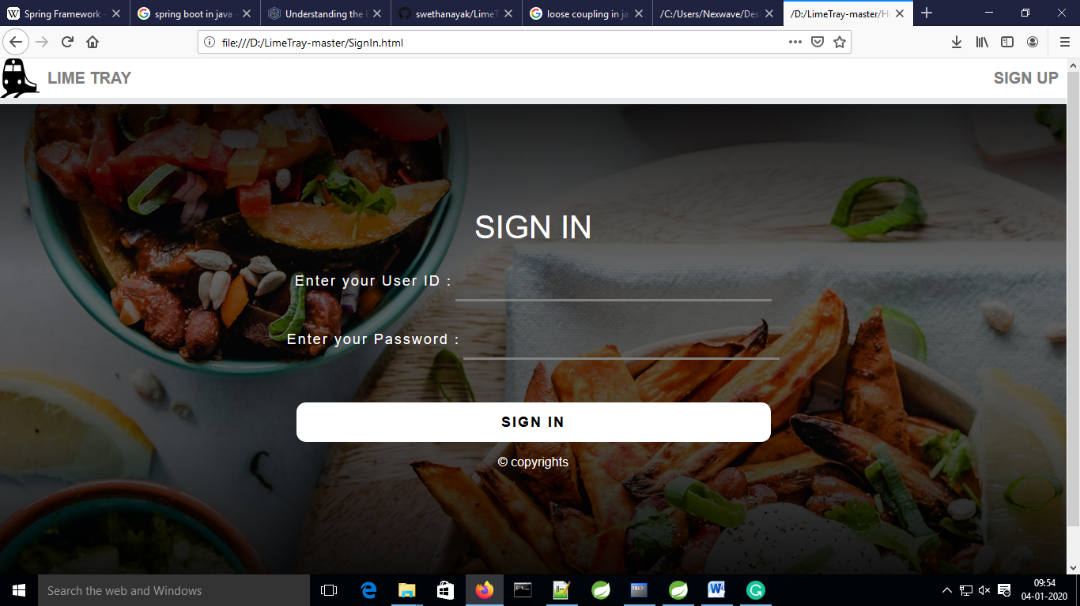

Slide 12
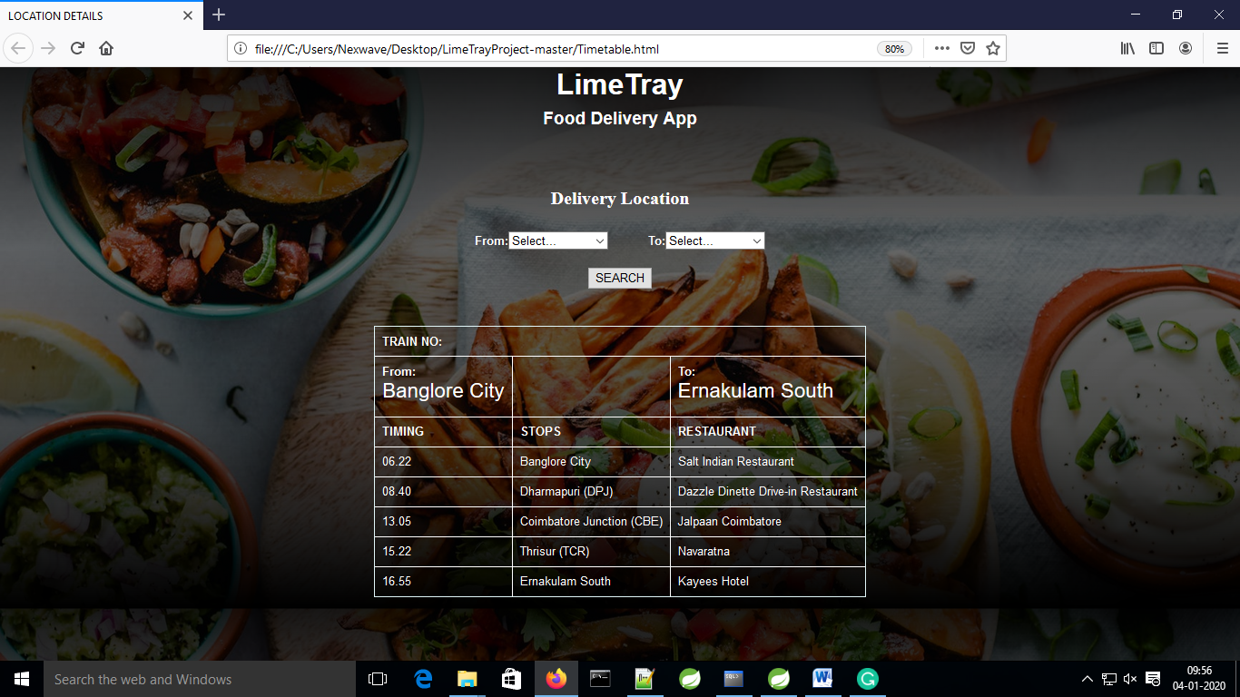
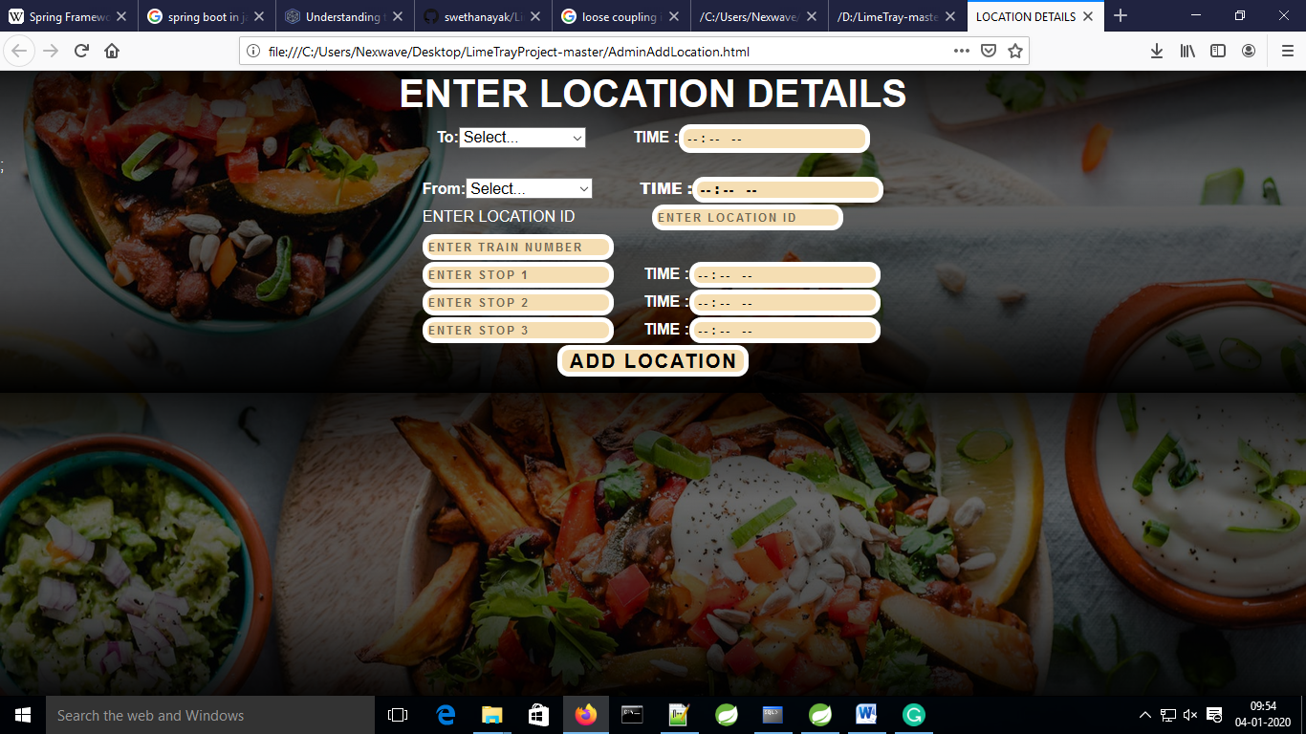

Slide 13
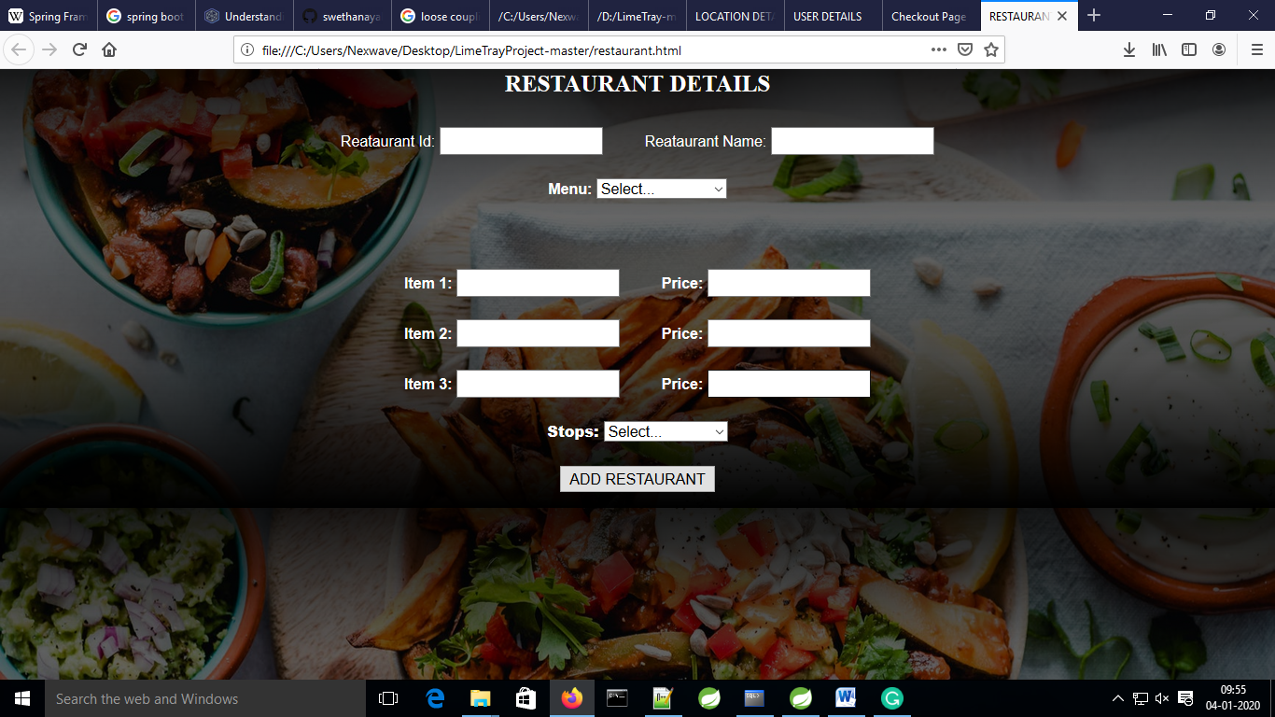
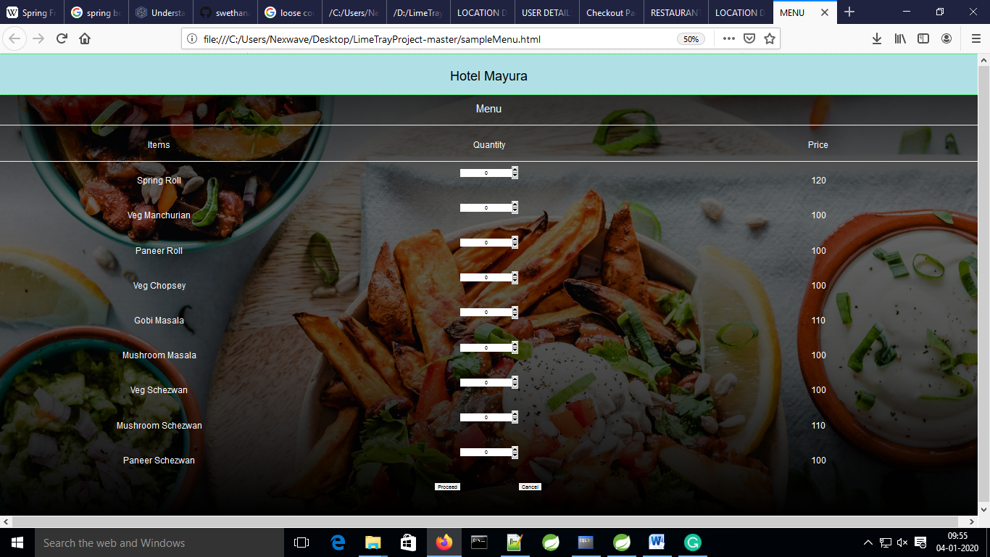

Slide 14
